Slide 1
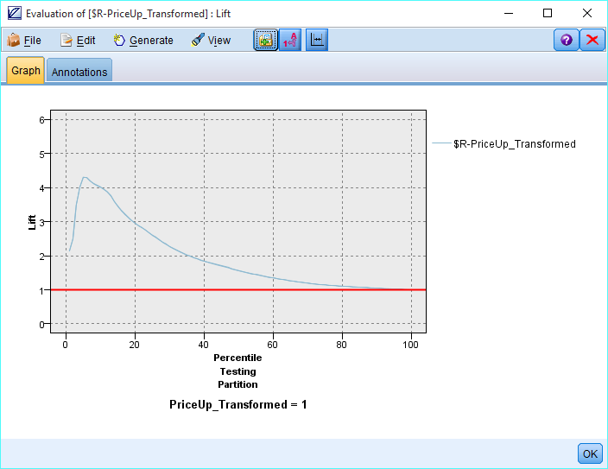
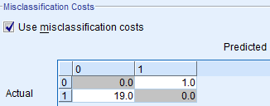
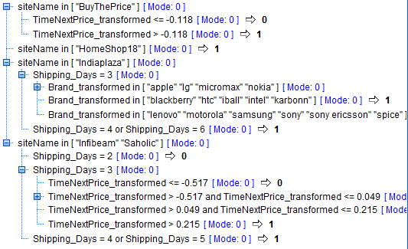
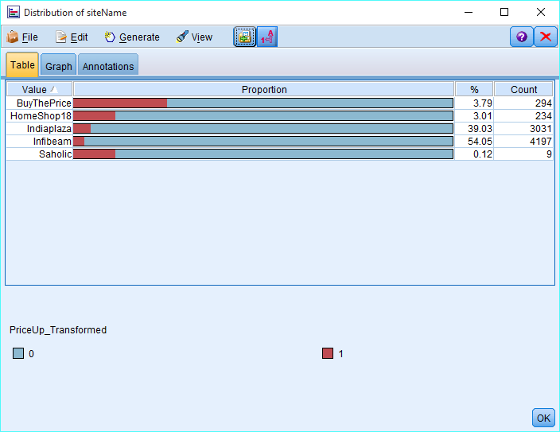
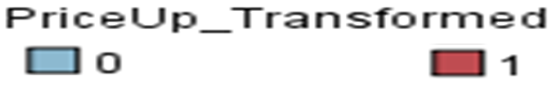
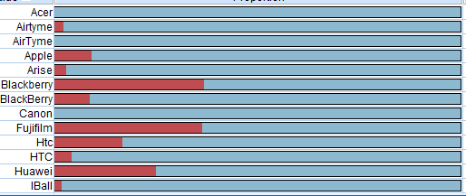

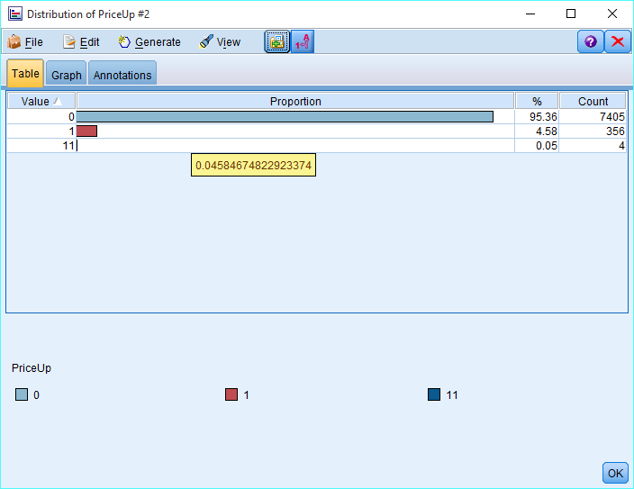

Company or University Logo
Price Change Prediction of Electronics in online shopping
PROBLEM
Data is made publicly available by theBargain.in website and has been collected from
https://inclass.kaggle.com/c/price-change-prediction-of-electronics-in-online-shopping
ANALYSIS
DATA
Through, final model, CHAID, we should get ~40% of success.(Lift Chart) using top 10% of the items .Without the model, we would get 10% of success only
Data is made publicly available by theBargain.in website and has been collected from
https://inclass.kaggle.com/c/price-change-prediction-of-electronics-in-online-shopping
How to compute Missing Values?
Following computation methods that make sense with the variable descriptions are used:
Color = Mode (Black)
avRating= 2.5 (Median)
ReviewCount = Median
Shipping period = Mode(2-3 days)
Background:
theBargain is an eCommerce Predictive Analytics company with an objective to insure that a Shopper buys products when the Price is Right. Their tool helps the shoppers to quickly focus on the best product choices available in the market. Our “Price Guarantee Engine” takes into consideration a comprehensive set of reliable and up-to-date data.
Name | Description
RowID | index number
name | Product name
brand | Brand of the Product
color | Color of the Product
freeShipping | 1 = YES, 2 = NO, 0 = Data unavailable
inStock | 1 = YES, 2 = NO, 0 = Data Unavailable
avRating | Average rating of the product
reviewCount | No. of users who rated the product
listPrice | Price of the product on "date"
shippingPeriod | Shipping period of the product
date | Timestamp of the product and price information (mm/dd/yyyy hh:mm)
siteName | Name of the website from which the product is sold
category | Category of the product
TimeNextPrice | number of days until the next available price information
group | always a value of 1 (required for administrative reasons).
PriceUp(Target) | whether the product price went up ("1") or not ("0") on the next time the price information is recorded ("TimeNextPrice")
How to handle Skewness in Target Variable?
In order to avoid misclassification, we need to Reweight priceup variable with misclassification costs.
Goal:
The goal is to accurately capture the 10% of most likely price increases (PriceUp=1). The performance measure used will be top 10% lift. This is computed by sorting the records according to PriceUp (probabilities), and counting how many among the 10% records with the highest probabilities were actually price increases. The higher the value, better the score.
Is the probability of price change higher on some sites?
Research Questions
What is the impact of skewed target variable
on the model, how to handle the skew ness?
Is the probability of price change higher on some sites?
Is the probability of price change higher for certain brands and category?
Is it possible to capture the 10% of most likely price increases (PriceUp=1) using top 10% lift?
Is the probability of price change higher for certain brands and category?
Conclusion
We determined that online price of the item is related to site name, brand name and category of the product. With our model, 21 out of top 10% items(39 items) are most likely to undergo price change.

